Slide 1
Engage DB
Social Media Engagement Analytics Database
A database system for tracking, managing, and analyzing social media engagement.
D SHRI VISHWA 25BCE5127
D NARASIMHAN 25BCE5028
SKANDhAN 25BCE5175

Slide 2
Problem statement
Social media platforms generate huge amounts of engagement data, including:
Likes , Saves , Reposts , Comments , Replies , Hashtags , Reach and impressions
The challenge:
Managing and analyzing these different types of engagement data efficiently requires a well-structured database.

Slide 3
Our Solution
ENGAGE DB is a relational database designed to:
Store user and post information
Track different engagement activities
Manage comments and replies
Analyze post reach
Track hashtags
Analyze comment sentiment
Understand user interaction patterns
Main goal : To provide a structured system for storing and analyzing social media engagement data.

Slide 4
Key Features of ENGAGE DB
User Management: Tracks users and their social connections.
Post Management: Stores different types of posts and their details.
Engagement Tracking: Tracks likes, saves, and reposts.
Comment Analysis: Tracks comments, replies, and comment likes
Hashtag Analysis: Tracks hashtags used in posts and comments.
Analytics: Tracks reach, impressions, and sentiment.

Slide 5
Core Entities
User & Social Network
USER
FOLLOWS
Content
POST
COMMENTS
Engagement
LIKES
SAVED
REPOSTS
COMMENT_LIKES
Hashtags
HASHTAG
POST_HASHTAG
COMMENT_HASHTAG
Analytics
REACH

Slide 6
Relationships
User creates Post (one-many)
User likes Post (many-many)
User saves Post (many-many)
User reposts Post (many-many)
Post gets Reach (one-one)
User comments on Post (one-many)
Post has Comments (one-many)
User likes Comment (many-many)
Comment replies to Comment (one-many)
User follows User (many-many)
Post has Hashtags (many-many)

Slide 7
Database Tables and Attributes
USER (user_id , user_name , follower_count , following_count)
Following table (follower_user_id , following_user_id 2)
POST (post_id , content_type , genre , post_date , language, user_id )
Likes (post_id , user_id)
Saved (post_id , user_id)
Reposts (repost_id , post_id , user_id , text_highlight)
Post_hashtag (post_id , hashtag_id)
Hashtag (hashtag_id , hashtag_name , purpose)
Comment_hashtag (comment_id , hashtag_id)
Comments (comment_id , comment_text , sentiment , user_id , post_id , towhom , numberofreplies , positive replies, negative replies)
Comment_likes (user_id , comment_id)
Reach (reach_id , impression , unique_reach , post_id)

Slide 8
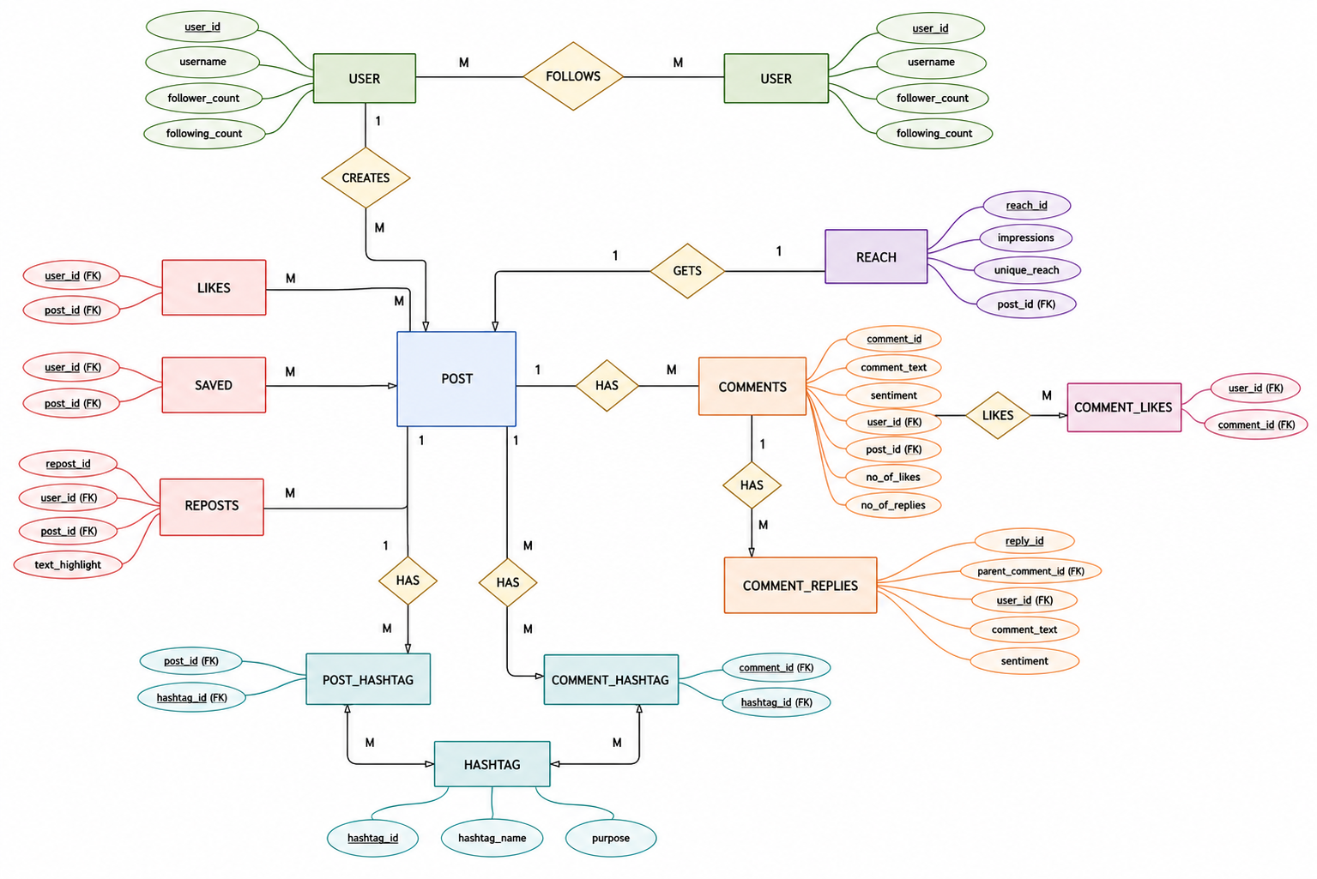
ER Diagram

Slide 9
Analytics and Insights
What Can ENGAGE DB Analyze?
Post Performance
Which posts receive the most likes?
Which posts are saved the most?
Which posts are reposted the most?
User Engagement
Which users are most active?
Which users receive the most engagement?
Comment Analysis
What is the sentiment of comments?
How many positive and negative replies exist?
Hashtag Analysis
Which hashtags are most popular?
Which hashtags generate higher engagement?
Reach Analysis
Which posts have the highest impressions?
Which posts have the highest unique reach?

